Slide 1
Module 3 Mapping short reads
Working with pathogen genomes
7th - 11th February 2022
Sophie Belman & Sushmita Sridhar

Slide 2
Objectives
Introduce data files required for mapping
Visualize mapped data in Artemis genome viewer
Show sequence variation e.g SNPs, INDELS

Slide 3
Workflow:
Paired-end sequence reads in FASTQ file *
Map against reference *
Create alignment
Call SNPS and create pseudogenomes *
Construct and interpret phylogeny
Extract variable sites
and convert format
Notes:
FastQ files (raw data) to phylogenetic trees to infer genetic relationships

Slide 4
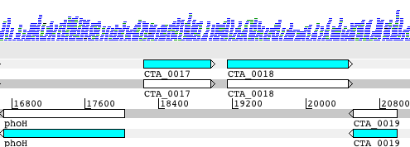
Workflow: generating sequencing reads and in silico analysis
Wet Lab
in silico analysis
FASTQ file
Bacterial cells
Extract DNA
Align reads to reference genome
Break into fragments (~500bp)
*
paired-end reads
Identify SNPs and INDELs,
Generate libraries
view in Artemis
Mapping is aligning a sequence to a known reference to determine genetic differences
DNA extraction and DNA library generation

Slide 5
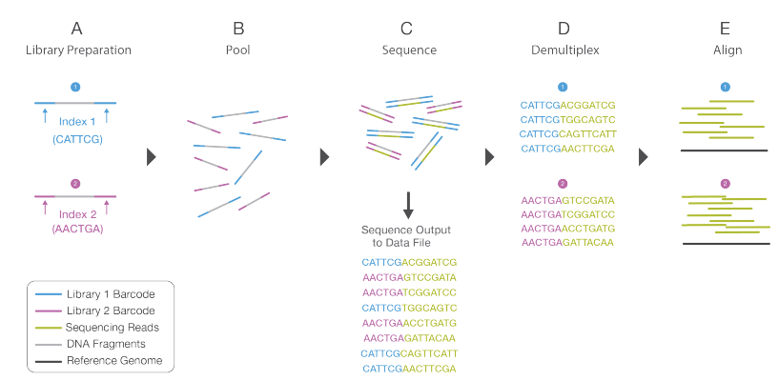
Illumina sequencing reads - fastq
https://emea.illumina.com/content/dam/illumina-marketing/documents/products/illumina_sequencing_introduction.pdf

Slide 6
Sequence output to Demultiplex
FASTQ file
@IL22_1561:1:1:1771:914
TTTTTTCAATACAATTTCATCTCTAATTTCAATTCAGCCTAA
+
>>>>7>>>>>>>>>>>>>>>>>>>:>5>>>96>+>>7;>>>>
@IL22_1561:1:1:1222:1105
ATGATATCATCTACACGGTTTAAAAATTCTGGACGGCTGATC
+
>>;>>>>>>>;>>>>>55>>>>>>>>>>>>+2>>8>>>>>57
@IL22_1561:1:1:1438:709
ACACCGATGACAATAATTGTTCCAATATCTGTAACAAAGCTA
+
<<<<<2<<2<<<<<<<<<)'<<<<<<<<<<+<;;7<)<<2<<
@IL22_1561:1:1:1671:1462
TGCAAGAACATTAGACAACGTATCTTCAATCGTTTATACAAG
+
>>7>:>:>>7>>7/:>>>7/.7>>>>>57>>0>>>>>>7>>>
@IL22_1561:1:1:1168:891
AATGGAAATCAAACTATAACTTCAACACTAAATGAGAAGCTA
+
>>>:7>>>>>>>>>>>>>>>>>>>>>>>>>>>>0>>>>>>>>
@IL22_1561:1:1:1097:1281
TAAAAGTATAACTTTCCATCACCAAAGTCAGAATTTACATCG
+
>>>>>>>>>>>>>>>>>>>>>>>>8>8>>>>>>>>>>>>>>>
TAG Strain
CGTGAT HGSA942
ACATCG 3HK
GCCTAA CHI59
TGGTCA CHI61
CACTGT BK2491
ATTGGC TUR9
GATCTG HU25
TCAAGT HU109
CTGATC HSJ216
AAGCTA FFP103
GTAGCC ICP5062
TACAAG GRE4

Slide 7
Fastq format
1
@SEQ_ID GATTTGGGGTTCAAAGCAGTATCGATCAAATAGTAAATCCATTTGTTCAACTCACAGTTT +
!''*((((***+))%%%++)(%%%%).1***-+*''))**55CCF>>>>>>CCCCCCC65
2
3
4
Line 1 begins with a '@' character and is followed by a sequence identifier and an optional description (like a FASTA title line).
Line 2 is the raw sequence letters.
Line 3 begins with a '+' character and is optionally followed by the same sequence identifier (and any description) again.
Line 4 encodes the quality values for the sequence in Line 2, and must contain the same number of symbols as letters in the sequence.

Slide 8
Fastq quality score/Phred score
The quality (Q), also called phred score, is the probability (P)
that the corresponding basecall is incorrect.

Slide 9
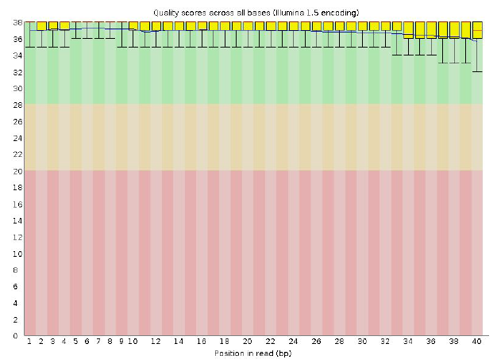
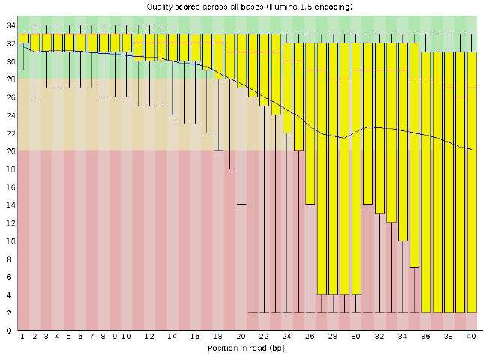
Fastq Quality Check made easy!
Good
Bad
https://www.bioinformatics.babraham.ac.uk/projects/fastqc/

Slide 10
Mapping Illumina sequence data
Isolate - Fastq files
Reference – in fasta format
@IL24_5151:3:1:1553:916#9/1
NAAACTACTTACACCCACTCAGGACACCAGGGACATCATTGCTGACGCCACGGCCTCACAGTGCTGAGCTGATGAT
+
$705291596=>>>>>=>=>=>==>>===>535:6=>=>>>=>==5:;318656:===991/1,-0,0015204.1
@IL24_5151:3:1:2173:904#9/1
NTTTTAACCGTACTTTCACCAGGATTATCGCAGGCGGATTCCTGGTGATTAATTTCAAAAAATAGCGTTTAATCCA
+
$948883999>==>>>>=>>=>>9>>>==>===>=>==>>:;:::===>=55:88>==>9:0;;:===>>==>>>5
@IL24_5151:3:1:2948:912#9/1
NCCACCAGACACTGTCCGCAACCCCGGTAAGGGGCCAACGTTAGAACATCAAACATTAAAGGGTGGTATTTCAAGG
+
>reference sequence
ATTGAACGCTGGCGGCAGGCCTAACACATGCAAGTCGAGCGGCAGCGGGAAGTAGTTT
TACTTTGCCGGCGAGCGGCGGACGGGTGAGTAATGTCTGGGAAACTGCCTGATGGAGG
GATAACTACTGGAAACGGTAGCTAATACCGCATGACCTCGTAAGAGCAAAGTGGGGGAC
TTCGGGCCTCACGCCATCGGATGTGCCCAGATGGGATTAGCTAGTAGGTGGGGTAATGG
TCACCTAGGCGACGATCCCTAGCTGGTCTGAGAGGATGACCAGCCACACTGGAACTGAG
CACGGTCCAGACTCCTACGGGAGGCAGCAGTGGGGAATATTGCACAATGGGCGCAAGC
GATGCAGCCATGCCGCGTGTGTGAAGAAGGCCTTCGGGTTGTAAAGCACTTTCAGCGAG
AGGAAGGCAGTCGTGTTAATAGCACGATTGATTGACGTTACTCGCAGAAGAAGCACCGGC
Choose your reference sequence wisely
You won’t find things in your sample that are not in the reference!
As sequences diverge from the reference, mapping becomes progressively less effective

Slide 11
Why do we map reads to a reference?
Identify variation:
Single Nucleotide Polymorphisms (SNPs),
insertions and deletions (indels)
Copy Number Variants (CNVs) between variants of the same bacteria.
Presence / absence of genes (AMR)

Slide 12
Mappers
There are lots of options
for mapping!
https://academic.oup.com/bioinformatics/article/28/24/3169/245777

Slide 13
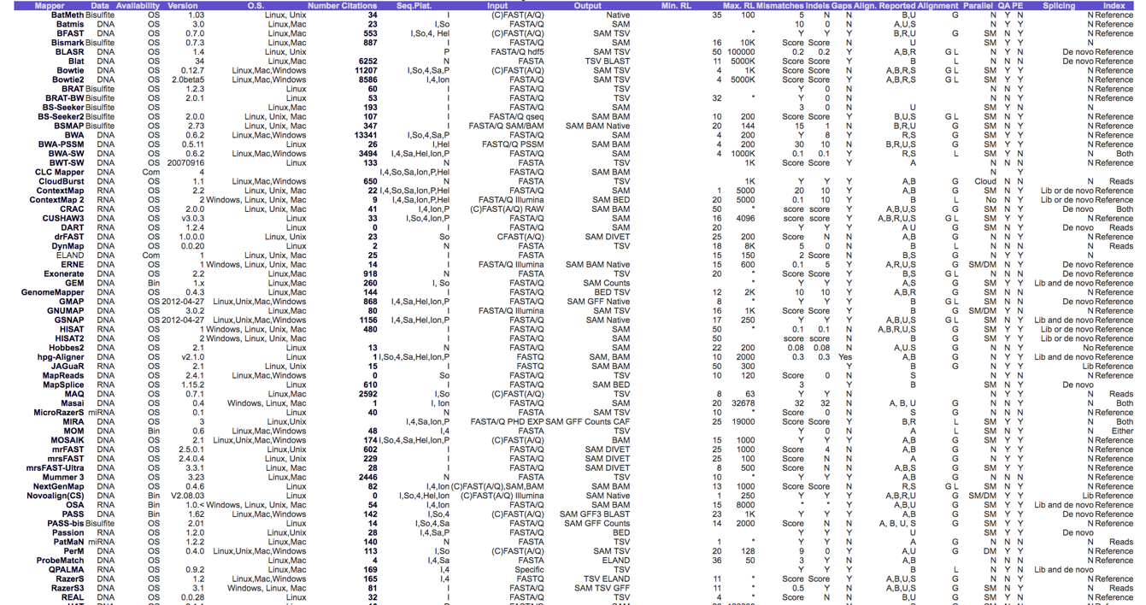
Comparison of different mappers
https://academic.oup.com/bioinformatics/article/28/24/3169/245777

Slide 14
Good general aligners
bwa
bowtie2
minimap2
Fast, sensitive and easy to use!
Splice-aware aligners for RNA-seq
STAR
HISAT2

Slide 15
Why do we map to a reference?
Identify variation:
Single Nucleotide Polymorphisms (SNPs),
insertions and deletions (indels)
Copy Number Variants (CNVs) between variants of the same bacteria.
Presence / absence of genes (AMR)
Notes:
Sophie starts presenting.

Slide 16
Single Nucleotide Polymorphisms (SNPs)
https://aschuerch.github.io/MolecularEpidemiology_AnalysisWGS/09-SNPphylo/index.html

Slide 17
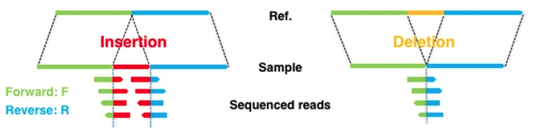
INDELS
https://www.nature.com/articles/s41598-018-23978-z

Slide 18
Visualize in Artemis

Slide 19
Why do we map to a reference?
Identify variation:
Single Nucleotide Polymorphisms (SNPs),
insertions and deletions (indels)
Copy Number Variants (CNVs) between variants of the same bacteria.
Presence / absence of genes (AMR)

Slide 20
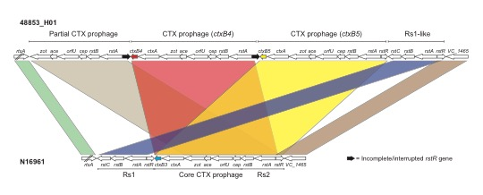
Copy number variation
Notes:
3 tandem repeats of CTX-1 prophage region. A recent 2018 paper had 4 tandem repeats of this region.

Slide 21
Gene presence/absence: AMR
Absence/Deletions is easier to spot
*To identify insertions is a little tricky.
Deletion:

Slide 22
Gene insertions/novel genes
In this instance you must investigate:
Metadata (phenotype)
Map to a different reference
If AMR/Virulence – map to a database
Assembly

Slide 23
The exercise:

Slide 24
Chlamydia trachomatis
Classification by tissue tropism
https://www.futuremedicine.com/doi/full/10.2217/fmb.13.80
Notes:
contagious, chronic inflammation of the mucous membranes of the eyes, caused by the bacterium Chlamydia trachomatis. It is characterized by swelling of the eyelids, sensitivity to light, and eventual scarring of the conjunctiva and cornea of the eye.

Slide 25
Whole Genome alignments. How do you distinguish between the strains?
STI
Ocular
LGV
LGV L2b
Notes:
Cinema curtains slide

Slide 26
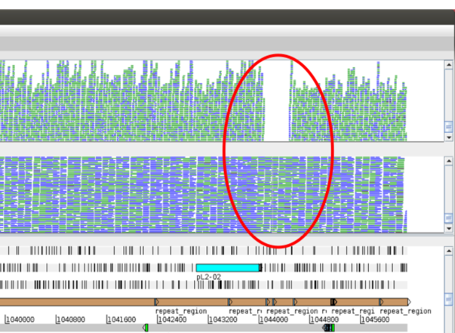
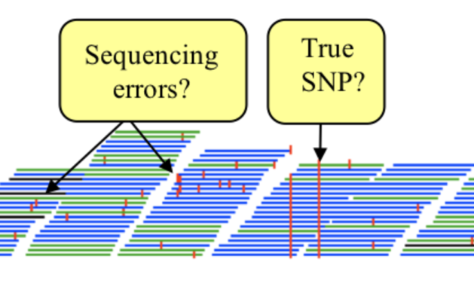
SNPs and presence/absence of genes
LGV
Genital
Ocular

Slide 27
Module 3: Mapping sequence reads workflow
Zipped Fastq files
Mapping (BWA-MEM)
SAM file
File conversion (samtools)
BAM file
1
3
VCF file
SNP calling(samtools)
View in Artemis
BCF file
2

Slide 28
Wrap-up
Paired-end sequence reads in FASTQ file *
Map against reference *
From Mapping to Phylogenetic trees: process to infer genetic relationships between strains
Create alignment
Call SNPS and create pseudogenomes *
Construct and interpret phylogeny
Extract variable sites
and convert format

Slide 29
Additional resources
Illumina sequencing platforms:
https://emea.illumina.com/systems/sequencing-platforms.html
Illumina sequencing by synthesis:
https://www.youtube.com/watch?v=fCd6B5HRaZ8
IGV:
https://software.broadinstitute.org/software/igv/

Slide 30
Popular short read sequencers

Slide 31
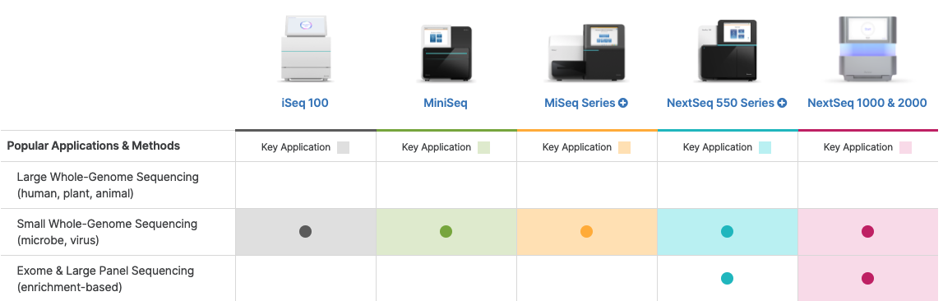
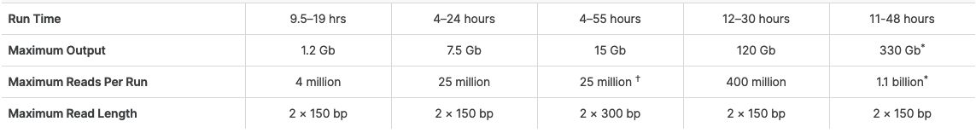
Illumina new generation short read sequencers
https://emea.illumina.com/systems/sequencing-platforms.html

